Slide 1
Chapter 14
MIS Impact on Society

Slide 2
Outline
How does your company affect the rest of the world? What influence does the outside world have on your company?
How does information technology affect individuals? As a manager and a company, do you treat individuals the way you expect to be treated by other companies?
How does technology affect jobs? If computers do more of the work, what jobs are left for people?
How does technology change the relationship between businesses and consumers?
Can information technology change education?
How does technology affect different areas of society?
Can information technology improve governments?
Do criminals know how to use computers?
How do your actions affect society? Is it possible to follow the laws and still be wrong?
What major laws affect technology and the use of computers?
What risks are created through using cloud computing?

Slide 3
The IT Environment
Education
Government
Consumers
Strategy
Tactics
Businesses
Culture
Privacy
Operations
Employees
Company

Slide 4
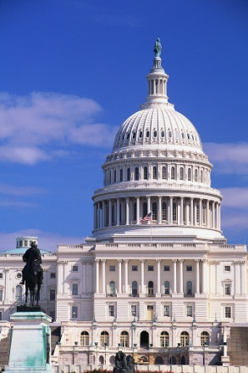
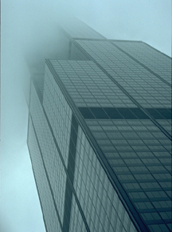


Privacy
Governments
Employers
Businesses

Slide 5
Privacy
criminal record
complaints
finger prints
transportation
medical
records
financial
regulatory
employment
environmental
financial
permits
census
grocery store scanner data
credit cards
purchases
phone
subscriptions
education
loans & licenses
Blogs
Social networks
organizations

Slide 6
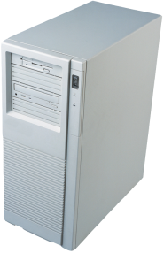
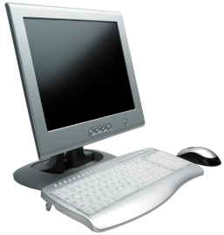
Cookies
Web server
Send page and cookie.
Use cookie to identify user.
Send customized page.
Find page.
time
Request page.
Display page, store cookie.
Request new page and send cookie.
User PC

Slide 7
Misuse of Cookies: Third Party Ads
Useful Web site
National ad Web site
Doubleclick.com
Link to ads
Requested page
Request page
Hidden prior cookie
Useful Web Page
Text and graphics
[Advertisements]
Ads, and cookie
User PC

Slide 8
Wireless Privacy
Cell phones require connections to towers
E-911 laws require location capability
Many now come with integrated GPS units
Business could market to customers “in the neighborhood”
Tracking of employees is already common

Slide 9
Location
http://www.loopt.com
Used by other applications as well.
Set tracking for your friends to find you.
http://www.foursquare.com
Check-in to stores to tell everyone where you are.
GM: On-Star
Continuous tracking of your vehicle, for a fee.
Insurance companies
Install tracking device to monitor driving performance and location for a reduced rate.
Any stored location data could be retrieved by the police or by lawyers in a court case. (And it has played a role for both prosecution and defense in several high-profile cases.)

Slide 10
Privacy Problems
TRW--1991
Norwich, VT
Listed everyone delinquent on property taxes
Terry Dean Rogan
Lost wallet
Impersonator, 2 murders and 2 robberies
NCIC database
Rogan arrested 5 times in 14 months
Sued and won $55,000 from LA
Employees
26 million monitored electronically
10 million pay based on statistics
Jeffrey McFadden--1989
SSN and DoB for William Kalin from military records
Got fake Kentucky ID
Wrote $6000 in bad checks
Kalin spent 2 days in jail
Sued McFadden, won $10,000
San Francisco Chronicle--1991
Person found 12 others using her SSN
Someone got 16 credit cards from another’s SSN, charged $10,000
Someone discovered unemployment benefits had already been collected by 5 others

Slide 11


Government and Privacy
Spying on “ordinary” people is not an issue.
Spying on business and political leaders or journalists can cause problems.
Collecting data on targeted individuals such as dissidents or minorities can stifle innovation.
Personal financial data
Company financial data
Health data
Travel data
Political negotiations

Slide 12
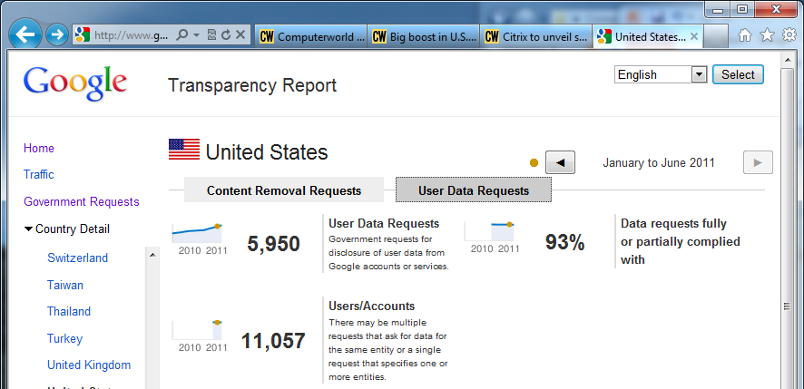
Google Transparency Report
Google reports on the number of government requests that it receives.
Content Removal Requests
User Data Requests
http://www.google.com/transparencyreport/

Slide 13
Privacy Laws
Minimal in US
Credit reports
Right to add comments
1994 disputes settled in 30 days
1994 some limits on access to data
Bork Bill--can’t release video rental data
Educational data--limited availability
1994 limits on selling state/local data
2001 rules on medical data
Europe
France and some other controls
1995 EU Privacy Controls

Slide 14
Primary U.S. Privacy Laws
Freedom of Information Act
Family Educational Rights and Privacy Act
Fair Credit Reporting Act of 1999 (FCRA)
Privacy Act of 1974
Privacy Protection Act of 1980
Electronic Communications Privacy Act of 1986
Video Privacy Act of 1988
Driver’s Privacy Protection Act of 1994
Identity Theft and Assumption Deterrence Act of 1998
2001 Federal Medical Privacy rules (not a law)
Fair and Accurate Credit Transactions Act of 2003 (FACTA)
For more, see: http://www.informationshield.com/usprivacylaws.html

Slide 15
Opt Out Lists
Stop telemarketers (phone calls)
http://www.donotcall.gov
Reduce junk mail
Mail Preference Service
Direct Marketing Association
P.O. Box 643
Carmel, NY 10512
Stop credit agencies from selling your data (credit cards)
Credit Bureau Screen Service
888-567-8688

Slide 16
Anonymity
Anonymity servers
Dianetics church (L. Ron Hubbard) officials in the U.S.
Sued a former employee for leaking confidential documents over the Internet.
He posted them through a Danish anonymous server.
The church pressured police to obtain the name of the poster.
There might be more secure anonymity servers.
Should we allow anonymity on the Internet?
Protects privacy
Can encourage flow of information
Chinese dissenters
Government whistleblowers
Can be used for criminal activity

Slide 17


Anonymity Server
If the anonymity server is monitored in real time, or if it keeps records, it is possible to trace back to the original source.
Temp IP Address
Anonymity Server
Proxy server
Web Server
The Web server, and investigators, see the IP address of the anonymity server, not the real user.

Slide 18
Job Changes 1995-2002
Home-health
Programmer/analysts
Travel agents
Childcare
Guards
Cooks
Nurses
Gardners
Lawyers
Teachers
Janitors
Bank tellers
Electrical assemblers
Typists/word processors
Machine-tool operators
Textile workers
Switchboard operators
Packaging operators
Telephone & cable TV installers
Directory-assistance operators

Slide 19
Job Changes
Database administrators, etc.
Computer engineers
Systems analysts
Personal and home care aides
Home health aides
Medical assistants
Teachers, special education
Adjustment clerks
Teacher aides
Child care workers
Social workers
Receptionists
Food service and lodging managers
Nursing aides, orderlies, etc.
Hand packers
Guards
Teachers, secondary school
Cooks, fast food
Registered nurses
Clerical supervisors
Food preparation workers
Maintenance repairers
Cashiers
General managers executives
Truck drivers
Food counter workers
Marketing supervisors
Waiters and waitresses
Salespersons, retail
General office clerks
http://www.bls.gov/news.release/ooh.table1.htm

Slide 20
Job Changes 2000-2010 (growth)
http://www.bls.gov/news.release/ecopro.t06.htm

Slide 21
Job Changes 2002-2012
Medical assistants
Network systems and data communications analysts
Physician assistants
Social and human service assistants
Home health aides
Medical records and health information technicians
Physical therapist aides
Computer software engineers, applications
Computer software engineers, systems software
Physical therapist assistants
Secretaries, except legal, medical, and executive
Stock clerks and order filers
Data entry keyers
Telemarketers
Postal service mail sorters, processors
Loan interviewers and clerks
Computer operators
Electrical and electronic equipment assemblers
Farmers and ranchers
Sewing machine operators
Word processors and typists
Telephone operators
http://www.bls.gov/opub/mlr/2004/02/art5full.pdf

Slide 22
Job Changes 2004-2014
Home health aides
Network systems and data comm. analysts
Medical assistants
Physician assistants
Computer software engineers, applications
Physical therapist assistants
Dental hygienists
Computer software engineers, systems software
Dental assistants
Personal and home care aides
Network and computer systems administrators
Database administrators
Machine feeders and offbearers
Order clerks
Office machine operators, except computer
Photographic processing operators
Computer operators
Telephone operators
File clerks
Sewing machine operators
Mail clerks and operators, except postal
Credit authorizers, checkers, clerks
Meter readers
Textile knitting and weaving machine operators

Slide 23
Job Changes: 2010 forecast
http://www.bls.gov/emp/

Slide 24
Growing Jobs 2004
Job | 2004 | Number | Percent
Home health aides | 624 | 350 | 56.0
Network systems and data communications analysts | 231 | 126 | 54.6
Medical assistants | 387 | 202 | 52.1
Physician assistants | 62 | 31 | 49.6
Computer software engineers, applications | 460 | 222 | 48.4
Physical therapist assistants | 59 | 26 | 44.2
Dental hygienists | 158 | 68 | 43.3
Computer software engineers, systems software | 340 | 146 | 43.0
Dental assistants | 267 | 114 | 42.7
Personal and home care aides | 701 | 287 | 41.0
Network and computer systems administrators | 278 | 107 | 38.4
Database administrators | 104 | 40 | 38.2

Slide 25
Declining Jobs 2004
Job | 2004 | Number | Percent
Secretaries, except legal, medical, executive | 1934 | -48 | -2.5
Stock clerks and order filers | 1566 | -115 | -7.3
Parking lot attendants | 122 | -11 | -8.7
Switchboard operators, answering service | 213 | -19 | -8.8
Telemarketers | 415 | -42 | -10.0
Farmers and ranchers | 1065 | -155 | -14.5
Word processors and typists | 194 | -30 | -15.3
Metal and plastic machine operators | 251 | -43 | -17.2
Chemical plant and system operators | 60 | -11 | -17.7
Machine feeders and offbearers | 148 | -27 | -18.0
Order clerks | 293 | -63 | -21.4
Office machine operators, except computer | 100 | -22 | -21.9
Photographic processing operators | 54 | -17 | -30.7
Computer operators | 149 | -49 | -32.6
Telephone operators | 39 | -14 | -35.7
File clerks | 255 | -93 | -36.3
Sewing machine operators | 256 | -93 | -36.5
Mail clerks and operators, except postal | 160 | -59 | -37.1
Credit authorizers, checkers, clerks | 67 | -27 | -41.2
Meter readers | 50 | -22 | -44.9
Textile winding, twisting, machine operators | 53 | -24 | -45.5
Textile knitting and weaving machine operators | 46 | -26 | -56.2

Slide 26
Growing Jobs: 2010
Occupations | Percent Change | Number of new jobs (thousands) | Wages | Education
Biomedical engineers | 72 | 11.6 | 77,400 | Bachelor
Network systems analysts | 53 | 155.8 | 71,000 | Bachelor
Home health aides | 50 | 460.9 | 20,460 | OJT
Personal and home care aides | 46 | 375.8 | 19,180 | OJT
Financial examiners | 41 | 11.1 | 70,930 | Bachelor
Medical scientists | 40 | 44.2 | 72,590 | Doctoral
Physician assistants | 39 | 29.2 | 81,230 | Master
Skin care specialists | 38 | 14.7 | 28,730 | Vocational
Biochemists and biophysicists | 37 | 8.7 | 82,840 | Doctoral
Athletic trainers | 37 | 6.0 | 39,640 | Bachelor
Physical therapist aides | 36 | 16.7 | 23,760 | OJT
Dental hygienists | 36 | 62.9 | 66,570 | Associate
Veterinary technologists | 36 | 28.5 | 28,900 | Associate
Dental assistants | 36 | 105.6 | 32,380 | OJT
Computer software engineers | 34 | 175.1 | 85,430 | Bachelor
Medical assistants | 34 | 175.1 | 85,430 | Bachelor
Physical therapist assistants | 33 | 21.2 | 46,140 | Associate
Veterinarians | 33 | 19.7 | 79,050 | Professional
Self-enrichment teachers | 32 | 81.3 | 35,720 | Work experience
Compliance officers | 31 | 80.8 | 48,890 | OJT

Slide 27
Declining Jobs: 2010
Occupation | Percent | Jobs lost (thousands) | Wages | Education
Textile dyeing machine operators | -45 | -7.2 | 23,680 | OJT
Textile winding, twisting | -41 | -14.2 | 23,970 | OJT
Textile knitting | -39 | -11.5 | 25,400 | OJT
Shoe machine operators | -35 | -1.7 | 25,090 | OJT
Extruding machine operators | -34 | -4.8 | 31,160 | OJT
Sewing machine operators | -34 | -71.5 | 19,870 | OJT
Semiconductor processors | -32 | -10.0 | 32,230 | Vocational
Textile cutting machine | -31 | -6.0 | 22,620 | OJT
Postal service sorters | -30 | -54.5 | 50,020 | OJT
Fabric menders | -30 | -0.3 | 28,470 | OJT
Wellhead pumpers | -28 | -5.3 | 37,860 | OJT
Fabric patternmakers | -27 | -2.2 | 37,760 | OJT
Drilling and boring machine operators | -27 | -8.9 | 30,850 | OJT
Lathe operators | -27 | -14.9 | 32,940 | OJT
Order clerks | -26 | -64.2 | 27,990 | OJT
Coil winders | -25 | -5.6 | 27,730 | OJT
Photographic processing | -24 | -12.5 | 20,360 | OJT
File clerks | -23 | -49.6 | 23,800 | OJT
Derrick operators | -23 | -5.8 | 41,920 | OJT
Desktop publishers | -23 | -5.9 | 36,600 | Vocational

Slide 28
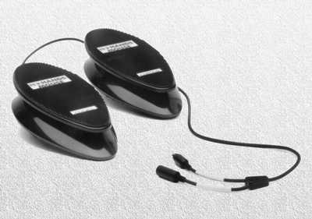
Adaptive Technology
http://www.footmouse.com
The foot mouse or nohands mouse uses one pedal to move the mouse and the other to click it.
Federal rules now require that all applications sold to the federal government have the ability to be used with adaptive technology to enable people with physical challenges to use the system.
A variety of hardware and software devices exist to provide alternative input and output.

Slide 29
Telecommuting
Employees
Suburban
work centers
Advantages
Reduced commuting costs.
Flexible schedule.
Disadvantages
Loss of personal contacts.
Distractions.
The Firm
Advantages
Decreased overhead.
Flexibility in part-time workers.
Disadvantages
Harder to evaluate workers.
Harder to manage workers.

Slide 30
Vendors v. Consumers
Intellectual Property
Patents—20 years, process patents are vague.
Copyrights—exact copies, 95 years or 70 years after the death of the author.
Digital Content
Copyright protects against large copiers, but hard to enforce against individuals.
Some firms chose to encrypt/protect data.
The Digital Millennium Copyright Act (DMCA) makes it a federal crime to circumvent copy protection methods.

Slide 31



Digital Rights Management (Microsoft)
Selection and purchase.
Customer money transfer to store.
Website
Purchase
Bank and credit
card processor
Customer/Reader
E-Commerce bookstore
Customer data.
Selection data.
Retail store data.
Encrypted book sent to customer with publisher-specified level of security.
Wholesale price charged to retailer.
Commission/fee to DAS server.
Money to publisher.
One copy in e-book format.
Manuscript
Digital Asset Server (DAS)
Author
Publisher

Slide 32

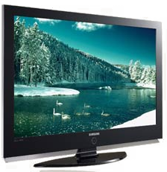
Digital Rights Management
Purchase item
Attempt to play (or share) on different computer and player software examines the rules/rights.
Content Server
Encrypted item
Tied to computer
Usage rules
Embedded user ID
Hardware devices validate entire chain to ensure no insecure devices will capture the signal to convert it. HDCP handles these issues with HD TV.

Slide 33
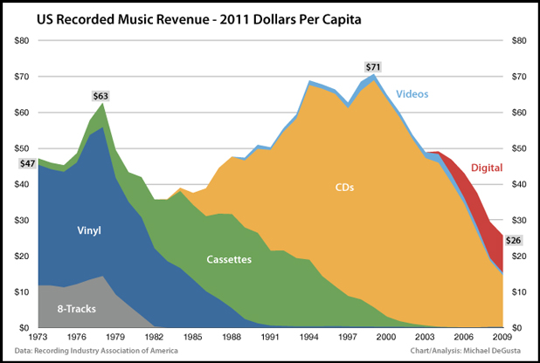
Music Sales
http://www.businessinsider.com/these-charts-explain-the-real-death-of-the-music-industry-2011-2
Michael DeGusta

Slide 34
Price Discrimination-1st degree
P
Charge each person the most he or she is willing to pay.
P1
S
P2
No price discrimination.
Price paid by everyone.
P*
D
Selling products online to individual customers opens the door to charging different prices to everyone. Is this process bad?
Q
Person 1
Person 2

Slide 35
Education
Can technology change education?
Computer-assisted instruction to provide individual attention
Course management
Distance learning
Do people want more technology in education?
Teachers
Students
Employers
Are the answers different for lifelong learning?
Professionals
Employers
Military

Slide 36
Social Group Interactions
Social Group Legitimacy
How do you know what is real?
How cynical do you need to be?
Access to technology
Hardware
Software
Internet (access and speed)
Economics and payment mechanism
E-mail access, spam, and harassment
Liability and Control of Data

Slide 37

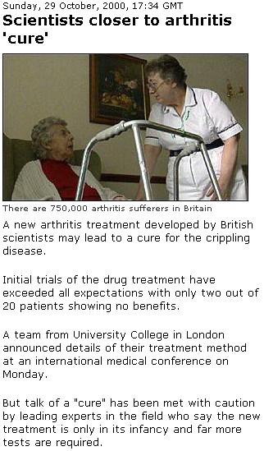
How Cynical Can You Be?
ArthritisCure.net
Which of these Web sites do you believe?
How do you decide?
Does it help if you know the Web site?
BBC News

Slide 38
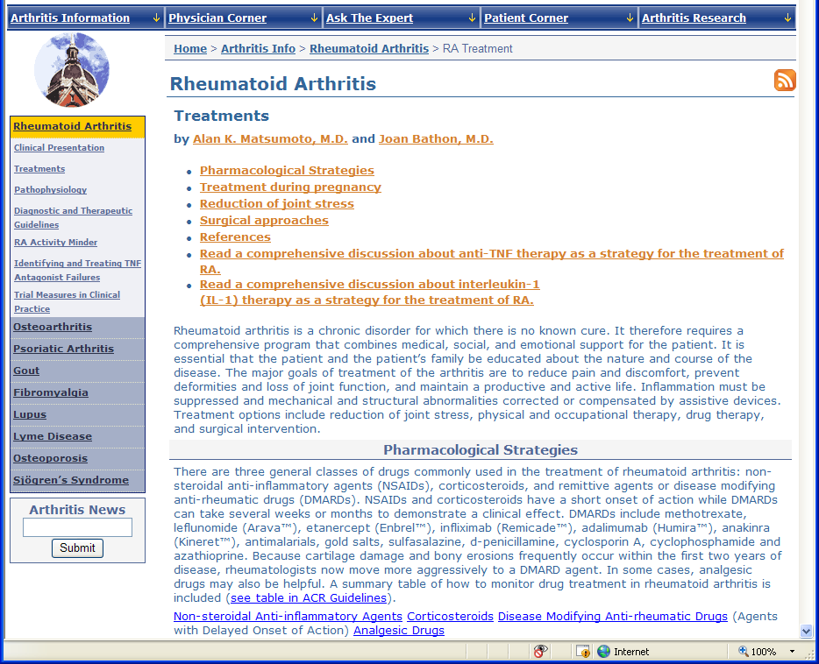
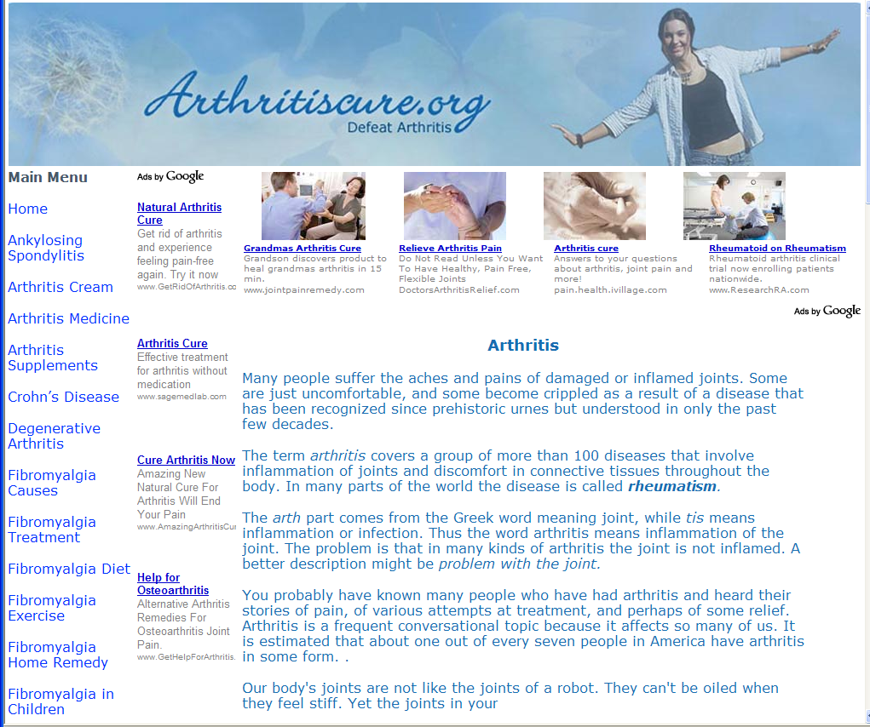
More Cures
http://www.hopkins-arthritis.org/
rheumatoid/rheum_treat.html
http://www.arthritiscure.org/
Look closely. This is not even a real site. It is a page designed only to sell ads.

Slide 39
International Internet Bandwidth
7,900 Gbps
2,700 Gbps
4,400 Gbps
619 Gbps
7,600 Gbps
http://www.telegeography.com

Slide 40
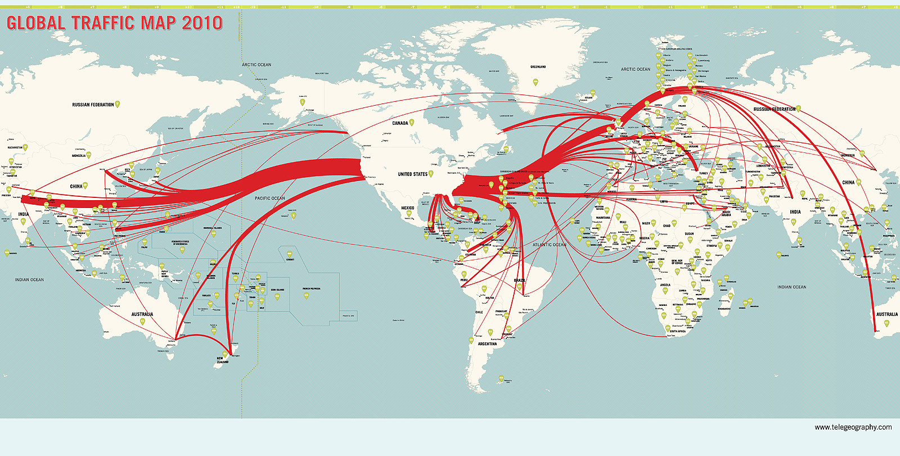
International Voice Traffic
http://www.telegeography.com/product-info/map_traffic/index.php

Slide 41
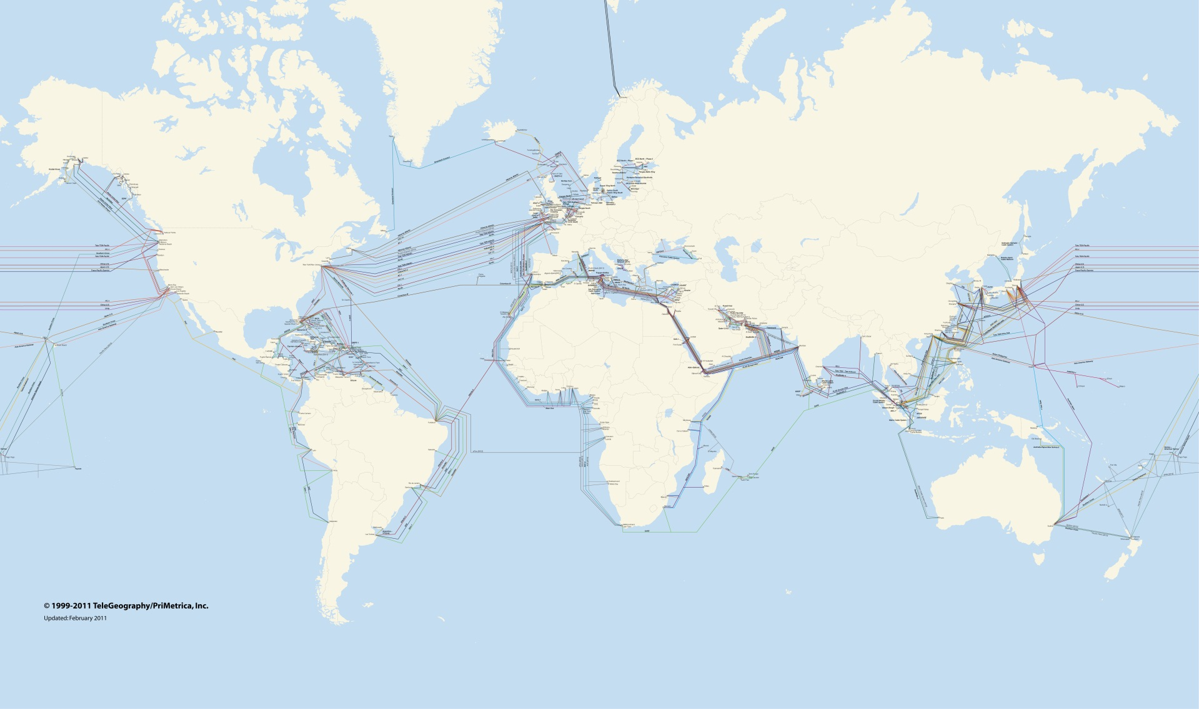
Submarine Cable Map
http://www.telegeography.com/product-info/map_cable/

Slide 42
E-Government
Government Representatives and Agencies
Providing Internet access to government data.
Democracy and participation
Getting data and information
Providing feedback and participating
Voting—will we ever see electronic or online voting?
Information warfare
Will the Internet consolidate the world?

Slide 43
Electronic Voting Challenges
Prevent fraud by voters (identify voters).
Prevent fraud by counters.
Prevent fraud by application programmers.
Prevent fraud by operating system programmers.
Prevent attacks on servers.
Prevent attacks on clients.
Prevent loss of data.
Provide ability to recount ballots.
Ensure anonymity of votes.
Provide access to all voters.
Prevent denial of service attacks.
Prevent user interface errors.
Identify and let voters correct data entry errors.
Improve on existing 1 in 6,000 to 1 in 10,000 error rates.

Slide 44
Information Warfare
Controlling information and knowledge
Intercepting communications.
Breaking codes.
Providing false information.
Protecting the modern economy.
Winning a war depends on destroying the economic infrastructure, which today includes computers and networks.
Stuxnet virus 2010 targeted Iranian nuclear facilities.

Slide 45
Rise of the World-State
Early history: City-States
People band together to protect a common region.
Economically and politically could only control limited areas.
Modern Era
Nation-State
Defense within physical boundaries (oceans and mountains)
International Cooperation
European Union
North American Free Trade Area
Mercosur and more
The Internet could remove boundaries
Laws and enforcement will require international cooperation.
Nations might become insular (e.g., France/Yahoo)
Companies might be forced to least-common denominator

Slide 46
France v. Yahoo
French law:
Illegal to trade Nazi memorabilia
Buy
Yahoo:
Auction site
Should a nation be able to set law for the rest of the world?
Auction: Sell Nazi…
France charged Yahoo with violating French law by allowing the sale of Nazi memorabilia online.
A French court convicted and fined Yahoo, although Yahoo had no physical presence in France.
A U.S. court later refused to grant France the ability to collect the money from Yahoo using U.S. courts.

Slide 47
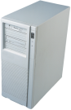
Microsoft v. Fujian Dongbai Group
Microsoft
Fujian Dongbai Group
Department Store
International cooperation on laws.
Microsoft accused the Chinese department store company of illegally copying software (copyright violation).
In April 2011, the company agreed to pay about $138,000 to Microsoft.
How is this case different from France v. Yahoo?
Several years ago, the U.S. government convinced China to create its own copyright law.
Microsoft accused the Chinese company within China.
http://online.wsj.com/article/SB10001424052748704071704576276321665235588.html?KEYWORDS=microsoft April 21, 2011

Slide 48
America v. WikiLeaks
Amazon
EveryDNS
PayPal
After cable postings, WikiLeaks servers are attacked—rumors mention government.
WikiLeaks moved to Amazon servers for bandwidth and capacity.
Government officials contacted Amazon. Amazon kicked out WikiLeaks for violating terms of service.
Government officials contacted PayPal for taking donations. PayPal dropped WikiLeaks.
EveryDNS dropped registration for WikiLeaks.
Uploads to WikiLeaks
Video from Iraq on alleged U.S. abuses.
U.S. military documents on Iraq and Afghanistan wars.
U.S. diplomatic “cables” or State Department e-mails, many classified “secret.”
Probably from Bradley Manning, U.S. private with access to network.
Should the U.S. government be able to pressure private companies?

Slide 49
Crime
Real-world/traditional crime
Criminals and terrorists have access to information, communication, and money.
Encryption and Anonymity
The Internet
Con artists have access to new and more victims.
Harassment (e-mail, cell phones, stalking, etc.)
Police Powers
Carnivore
Echelon
“Wire” tapping
Privacy
Freedom of Speech (Digital Millennium Copyright Act)

Slide 50
Responsibility and Ethics
Users
Copyright Laws
Confidentiality
Programmers and Developers
Secure Code
Confidentiality and Privacy
Know your Limitations
Companies
Provide the tools to enable employees to do their jobs efficiently and legally.
Training, compliance, security, backup.
Partnerships and non-disclosure agreements.
Governments
Infrastructure
Laws
Privacy

Slide 51
Legal Environment
Property Rights (ownership)
Privacy
Crime (destruction)

Slide 52
Property Rights
Copyright
Right to sell
Right to make copies
Right to make derivative works
Registration is not required, but increases the amount of money you can receive in a lawsuit
In force for “life” + 50 years (corporate is 75 years total)
Cannot copyright raw data
Patent
More expensive to obtain ($10,000 +)
Prohibits similar works, even if created independently.
20-year limitation (from date of filing)
Useful and innovative
Digital Millennium Copyright Act (DMCA) of 1998
Made it a federal crime to distribute devices that circumvent protection
(Probably) made it a federal crime to discuss ways to circumvent
Trademark
Prevents use of a name or logo
Trade Secret
Non-disclosure agreement (NDA)
Minimal legal protection, but establishes contract

Slide 53
Privacy
Freedom of Information Act | Gives public access to most government files
Family Educational Rights and Privacy Act | Limits use of educational records
Fair Credit Reporting Act | Gives public access to their credit data
Privacy Act of 1974 | Limits collection of government data—Most provisions are superceded and eroded by later legislation.
Electronic Communications Privacy Act of 1986 | Extended wiretap protections to cell phones and e-mail.
Video Privacy Act of 1988 | Limits access to video and library rental lists (Bork Bill).
Driver’s Privacy Protection Act of 1994 | Limits access to drivers’ license records to large companies (e.g., insurance).
Graham-Leach-Bliley Act of 1999 | Added some minor financial privacy clauses into financial deregulation. Institutions must notify customers of the ability to remove their names from marketing lists.
Communications Assistance for Law Enforcement Act (CALEA) 1994 | Requires telecommunication firms to pay for wiretap facilities. In 2004, the FTC began discussions to extend this requirement to computer systems.

Slide 54
Privacy
Health Insurance Portability and Accountability Act (HIPAA) of 1996 | Requires healthcare organizations to obtain patient signatures to release data.
Identity Theft and Assumption Deterrence Act of 1998 | Makes it illegal to steal identification data, not just the use of the data.
Children’s Online Privacy Protection Act of 1998 | Places limits on the collection of data online from minors.
U.S. Patriot Act (antiterrorism) of 2001 | Pretty much lets police agencies do anything they want for a given period of time as long as they claim it is related to terrorism.
CAN-SPAM Act of 2003 | Requires commercial e-mail to include legitimate opt-out provisions and to list physical addresses.
Fair and Accurate Credit Transactions Act of 2003 (FACTA) | Access to free reports and to add fraud alerts. Merchants can print no more than the last 5 digits of a CC number.

Slide 55
Privacy
Government expansion/intrusion
Welfare laws require identification because of fraud--some states use fingerprints
Identification databases: fingerprints nationwide, DNA proposal
“Deadbeat dads” 1999 act requires SSN to receive any license (driver’s, fishing, building, etc.)

Slide 56
Crime
Computer Fraud and Abuse Act of 1986 outlaws
access to computers without authorization
damage to computers, networks, data, and so on
actions that lead to denial of service
interference with medical care
Enforcement by U.S. Secret Service
Enforcement has been difficult, but some successes

Slide 57
Year | US Code | Act
1970 | 15 §1681 | Fair Credit Reporting Act
1974 | 20 §1232g | Family Educational Rights and Privacy Act
1974 | 5 §552a | Privacy Act
1984 | 18 §1029-2030 | Computer Fraud and Abuse Act
1986 | 18 §2510 | Electronic Communications Privacy Act
1987 | 15 §271-278; 40 §759 | Computer Security Act (federal computers)
1988 | 18 §2701 | Video Privacy Act (Bork Bill)
1994 | 18 §2721 | Driver’s Privacy Protection Act
1994 | 47 §1001 | Communications Assistance for Law Enforcement Act
1996 | 42 §201 | Health Insurance Portability and Accountability Act
1998 | 15 §6501 | Children’s Online Privacy Protection Act
1998 | 17 §1201 | Digital Millennium Copyright Act (non-circumvention)
1998 | 18 §1028 | Identity Theft and Assumption Deterrence Act
1999 | 15 §6801-6810 15 §6821-6827 | Graham-Leach-Bliley Act (privacy and fraudulent access to financial information)
2001 | 18 §1 | USA Patriot Act
2002 | 18 §1030 | Cyber Security Enhancements Act (Homeland Security)
2003 | 15 §1681 | Fair and Accurate Credit Transactions Act
2003 | 18 §1037 | CAN-SPAM Act

Slide 58
Law Web References
fedlaw.gsa.gov Basic links
thomas.loc.gov U.S. Code and C.F.R.
www.lawcircle.com/observer Commentary
lcweb.loc.gov/copyright U.S. copyright office
www.uspto.gov U.S. patent office
www.copyright.com Copyright clearance
www.eff.org Electronic frontier found.
www.epic.org Privacy information center
www.uspto.gov/web/offices IITF white paper,
/com/doc/ipnii proposed copyright changes
www.wired.com Issue 4(1): Analysis of IITF

Slide 59
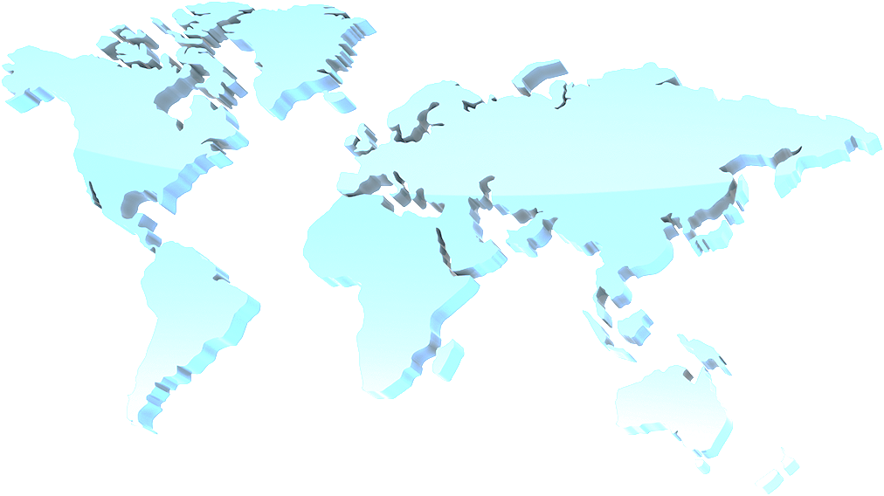
Public Cloud Computing: Data Location
If your data is transferred across multiple borders and stored in multiple countries. What national rules need to be followed? What countries might seek to control or limit your use of the data?
http://www.google.com/transparencyreport/governmentrequests/

Slide 60

Public Cloud Computing: Shared Servers
Company 1 (you)
Company 2
What happens to your data if the police confiscate a server because of the actions of second company sharing that server?
What happens if people attack a second company that is sharing your cloud-based server?
Police

Slide 61
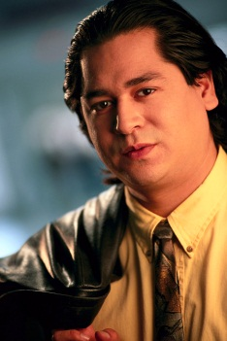



Public Cloud Computing: Subcontractors
Main contractor
Your company
You are responsible for security and privacy of your data. You can add conditions to the main contract.
But how do you control all levels of subcontractors and hired workers—in different countries?
Subcontractor
Subcontractor
Hired workers

Slide 62
Technology Toolbox: Privacy
Web Browsers
Microsoft IE: InPrivate
Google Chrome: Incognito (through settings)
Mozilla Firefox: Private browsing
Control Cookies
Never accept third-party cookies
Experimental
Tell sites not to track
Currently (2011) no standards exist, no site reads, much less follows the directive, and no laws exist to require its use

Slide 63
Quick Quiz: Privacy
1. Can you prevent Web sites from collecting your personal data?
2. What do you gain by blocking third-party cookies?
3. Why would you not want to use “Private” or “Incognito” browsing all the time?

Slide 64
Technology Toolbox: Global Environment
Foreign Currency | 1 US Dollar Equals
Euro (EUR) | 0.83724
Japanese Yen (JPY) | 106.650
British Pound (GBP) | 0.54975
Australian Dollar (AUD) | 1.32556
Mexican Peso (MXN) | 11.27800
http://www.oanda.com
http://www.xe.com/ucc
http://www.x-rates.com
Language translation by machine is weak but sometimes useful.
http://www.google.com/translate
http://babel.altavista.com
http://www.freetranslation.com
http://www.worldlingo.com
http://www.tranexp.com
http://www.dictionary.com

Slide 65
Quick Quiz: Global Environment
1. What cautionary messages do global websites use when converting currencies?
2. If you cannot afford a human translator, is it better to leave your website in English, or to use a machine translation?

Slide 66
Cases: Healthcare

